Slide 1
Data experiment
Aleksandar Popovic

Slide 2

Agenda
Overview of data
Timeline of events
Events by category
User Analysis
Conclusion

Slide 3
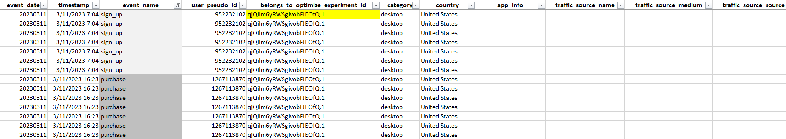
Raw Data
Goal: Increase sign_up & purchase events.
Two experiment groups:
Control Group ‘ExperimentID.0’
Alternative Group ‘ExperimentID.1’

Slide 4
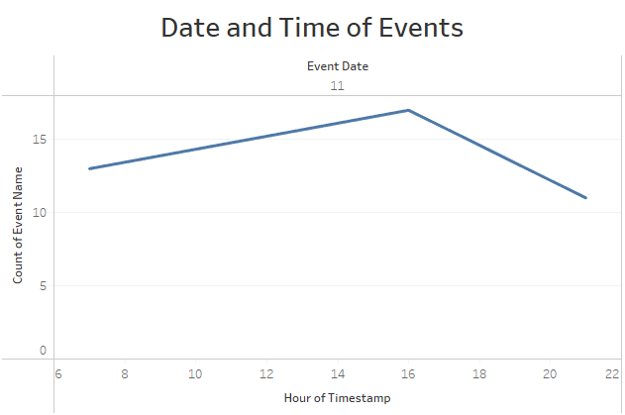
When did the events occur
Visual representation of the date and time of all sign-up and purchase events
All sign-up and purchase events in the dataset took place on March 11th
All of these events belong to the Alternative group

Slide 5
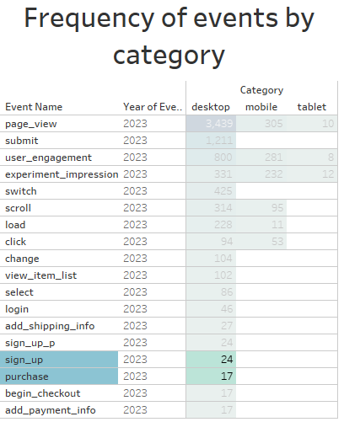
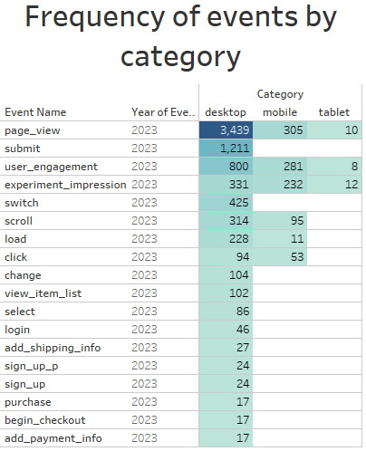
Events by Category

Slide 6
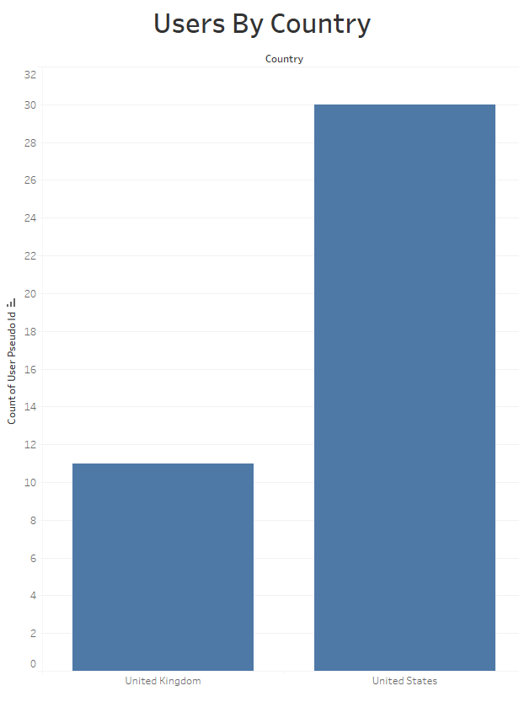
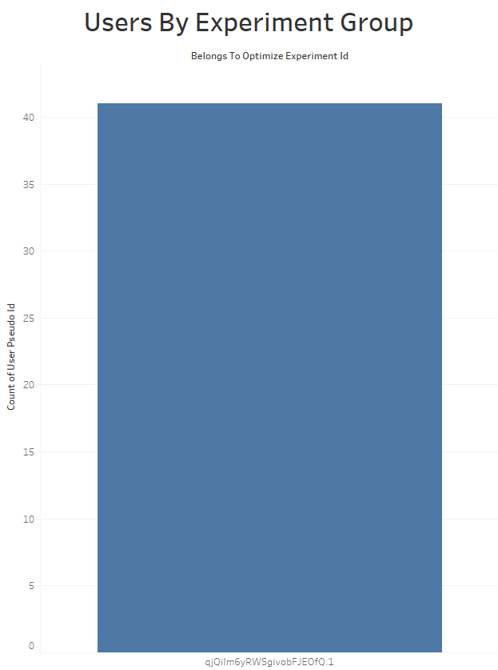

Users
Visual of users by country and experiment groups for target events:
‘ExperimentID.1’

Slide 7



Conclusion
The targeted events were triggered exclusively on desktop devices
The target audience for these events consists of users located in the USA and UK
On March 11th, our purchase event was triggered at 4pm, while sign-ups occurred at 7am and 9pm

Slide 8




Thank you
Aleksandar Popovic
apopovic997@gmail.com

